Slide 1
To replace with my own drawing

Slide 2
CSS143 Computer Programming (II)

Slide 3
Lecturer
Dr. Peng Du
High performance computing
Matrix stuff
Cloud computing
Kubernetes, docker, etc
Teaching
CSS 342 &CSS 143

Slide 4
Class Info
Syllabus
https://github.com/pdgetrf/CSS143B-2020Fall/blob/master/README.md
Canvas
Only used for notification and publishing grades
Discord
Invite: https://discord.gg/tQy6tZg

Slide 5
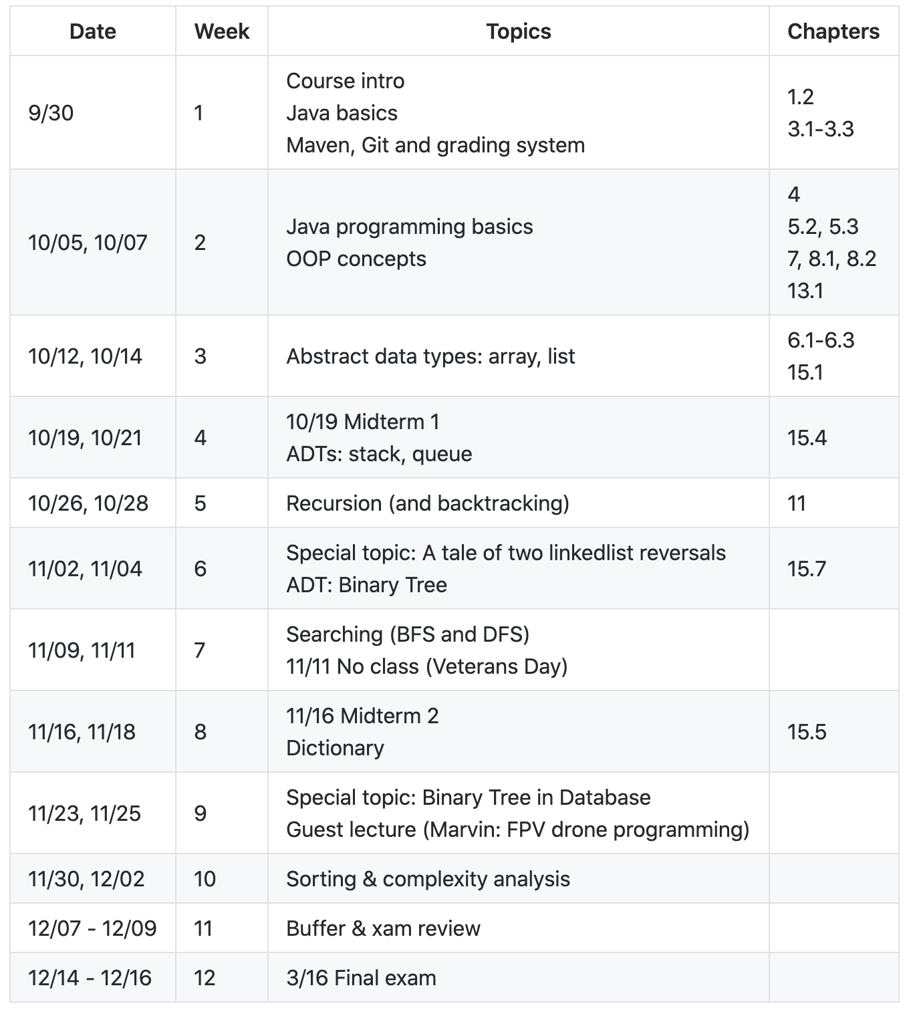
Class Info

Slide 6
Lecture Style
Slides
Demo Code from lecture
15-min Quiz, open book
Two midterms and one final (dates in syllabus)
Hands on (lots of coding)

